Slide 1

B.M.S College of Engineering P.O. Box No.: 1908 Bull Temple Road, Bangalore-560 019 DEPARTMENT OF INFORMATION SCIENCE & ENGINEERING OOPS USING C++ Faculty in Charge: Prof Shubha V Rao Project topic: Phone registry using linked list
Presented by:
Meghashree B B -1BM19IS088

Slide 2
PROBLEM STATEMENT
A Book that gives a list of the names , addresses and telephone numbers of the people is called a phone directory. A phone directory is one of the most useful tools of information in communication. From time to time we have come across many directories, whether in hard or soft print, but most people however overlook their importance due to lack of proper knowledge on their use and benefits. Hence we have tried to recreate the phone directory in our program “Phone Registry” using OOPs concepts in C++ . The difference between these two is that we can add, modify and delete a record in the phone registry but not in the phone directory. The features of phone registry are adding, listing, searching, modifying, deleting records and also reversing the order of the records. All these operations are done through file handling, i.e all the added and modified data are recorded in a file called ”Recordbook”, and the deleted information is removed from the program file. Here the information of the people are linked using a data structure called Linked list. The phone registry contains Name, Address, Birth year and Phone number of a person.

Slide 3
OVERALL PROJECT DIAGRAM
Constructor called
File initialized
If file not empty, the existing records are copied to the list created through read operation
The files are overwritten with the contents of the list
Operations like add, modify, delete, reverse, search, print performed as required by the user

Slide 4


SOFTWARE USED
The requirements necessary for this project are:
Operating system - windows/linux/iOS
Code editor - Visual Studio Code

Slide 5
OOPS CONCEPTS USED
Classes and objects
Polymorphism
Encapsulation and abstraction
Operator overloading
Function overloading
Friend function
Files
Modularity
STL - List

Slide 6
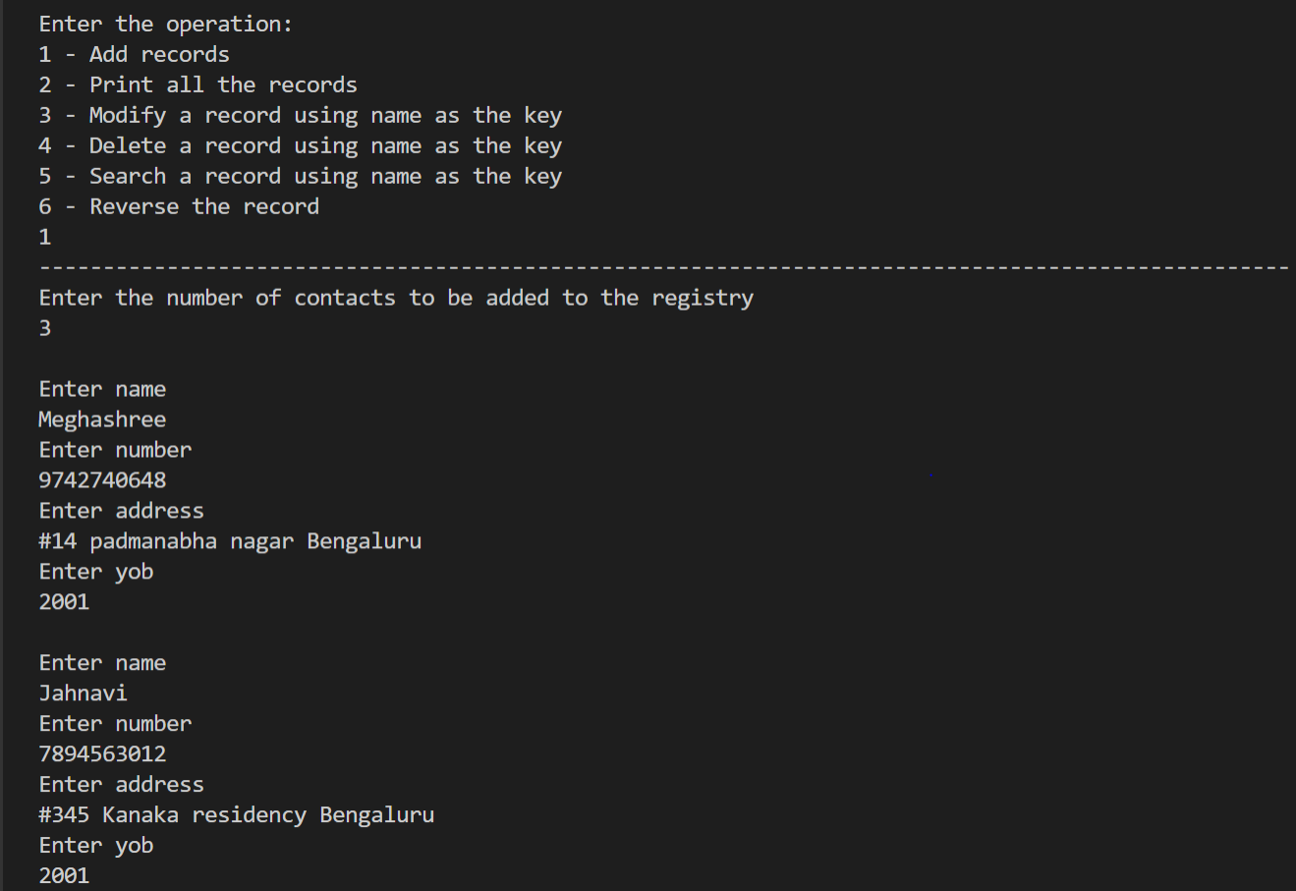
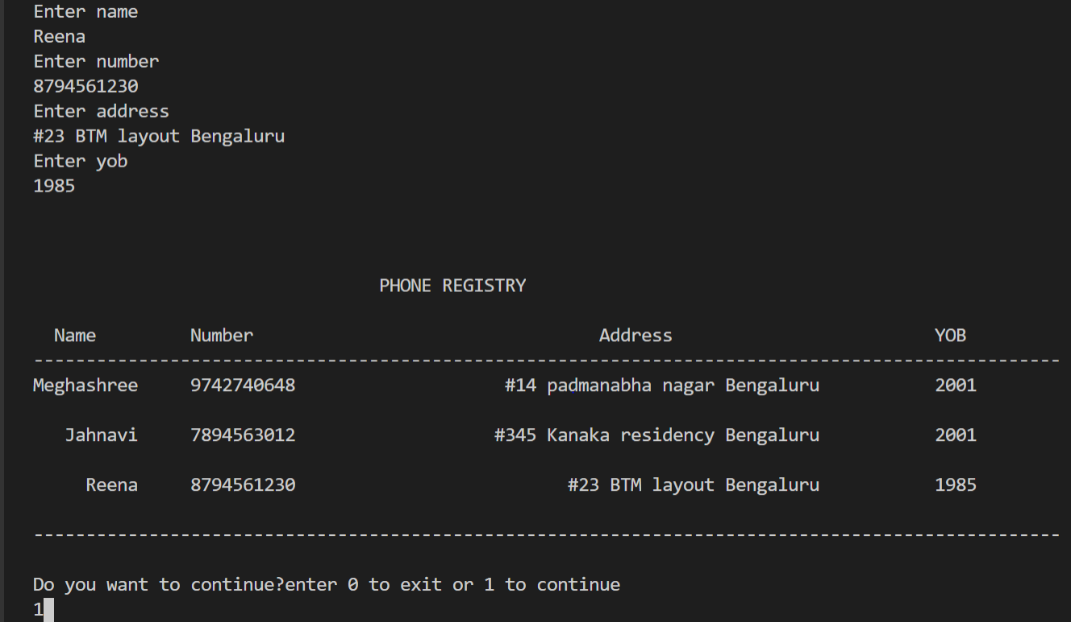
SNAPSHOTS Adding new records

Slide 7
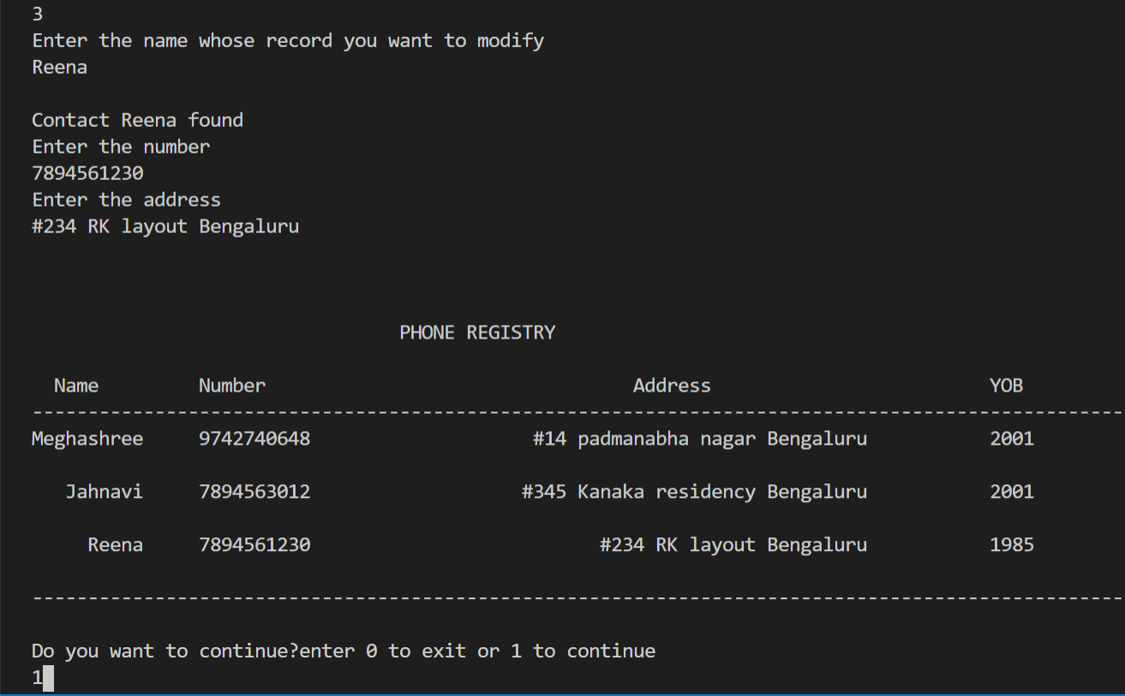
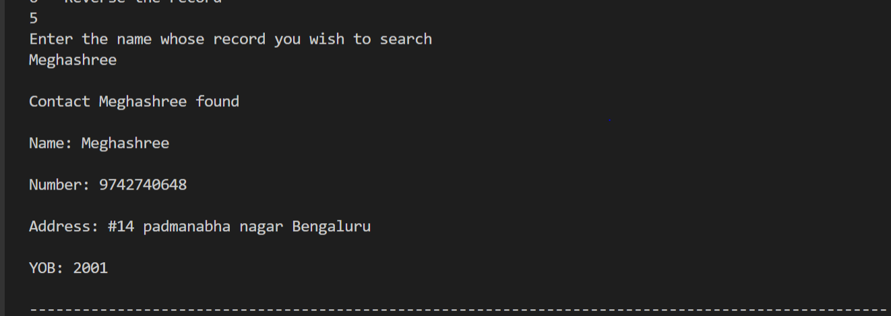
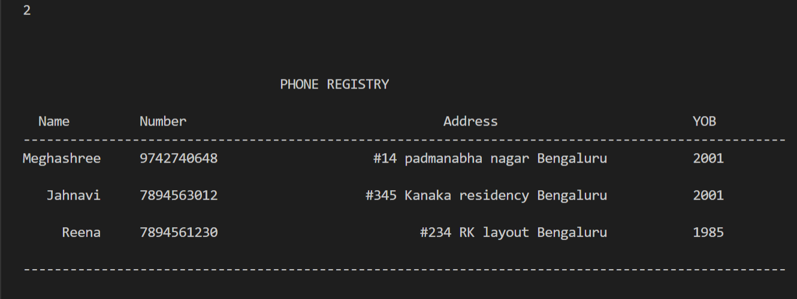
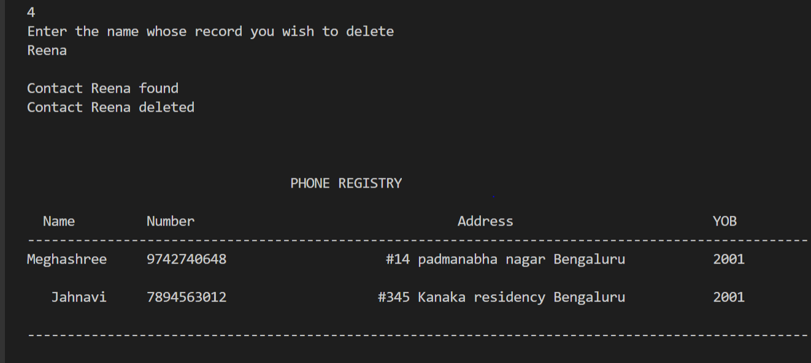
Modifying a contact
Searching a contact
Print details of all contacts in the record
Delete a contact using name as a key

Slide 8
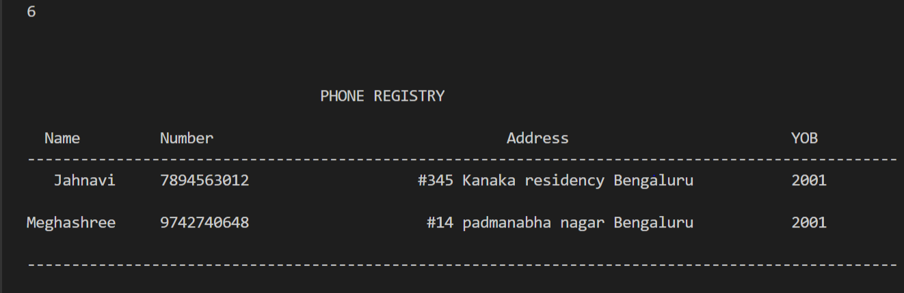
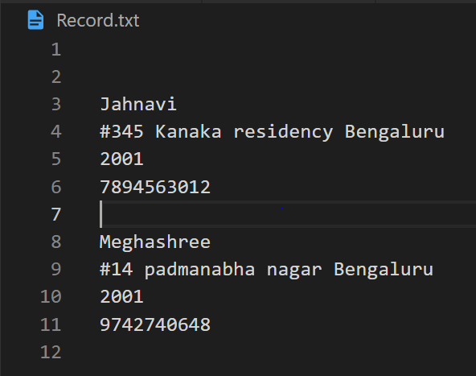
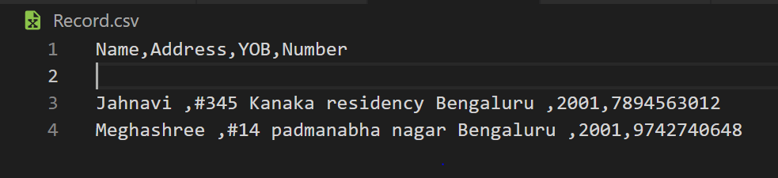
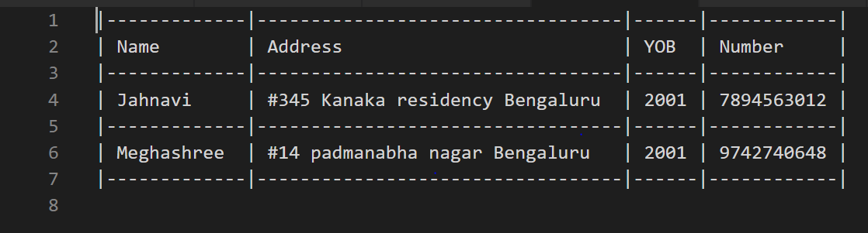
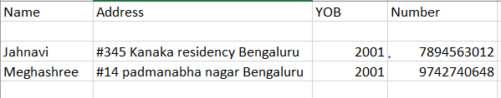
Reverse the order of the record
RecordBook.txt generated
Record.csv generated
Record.csv in the tabular format

Slide 9
THANK YOU!

